Slide 1
Software Design and Architecture
Lecture-1

Slide 2
What is Design?
Design is the first step in the development phase for any engineered product or system.
Design is about HOW the system will perform its functions.
It is the process of defining a system in sufficient detail to permit its physical realization.
It provides the overall decomposition or a representation of the system.

Slide 3
What is Software Design?
A software design is a meaningful engineering representation of some software product that is to be built.
A design can be traced to the customer's requirements and can be assessed for quality against predefined criteria.
It lays down the groundwork for achieving non-functional requirements (performance, maintainability, reusability, etc.)
It takes target technology into account (e.g., kind of middleware, database design, etc.)
It is an abstraction of the system.

Slide 4
Design: An Abstraction
From abstractions to systems
  abstractions allow us to ignore implementation details of procedures and data structures
  for large systems, we need to abstract away even more detail
  we need to represent higher level abstractions

Slide 5
Viewpoints/Representations
Viewpoints help in creating abstractions
A viewpoint tells you which details you can ignore when forming an abstraction
It defines which details are relevant and which are not
Viewpoints can overlap
  Some aspects of a design are common to several viewpoints

Slide 6
Viewpoints/Representations
Example: Building a house
Useful viewpoints:
the architect’s viewpoint (plan views, elevations, etc)
the plumber’s viewpoint (routing diagrams for pipework, fittings layouts, etc)
the electrician’s viewpoint (wiring diagrams, etc)
the buyer’s viewpoint (artist’s impression, floorplans, etc)
etc…

Slide 7
Design Representations
Design representations will:
  help us to see the big picture
  allow us to communicate our designs with others
    customers, managers, other developers,
    people with varying technical expertise
  allow us to measure various quality attributes
    completeness, consistency, complexity

Slide 8
Software Design Representations
Structural
  Static properties
Functional
  Tasks performed by system,
Behavioural
  Cause and effect, system behaviour
Data Modeling
  Data objects and their relationships

Slide 9
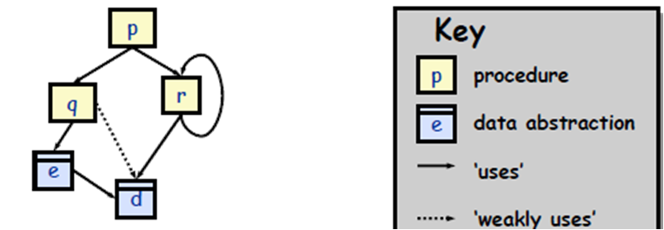
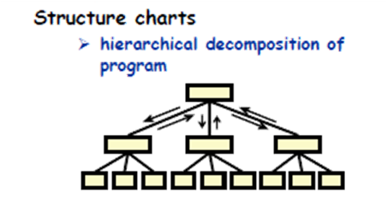
Structural Representation
Usually expressed by
  Dependency graphs
  Structure charts

Slide 10
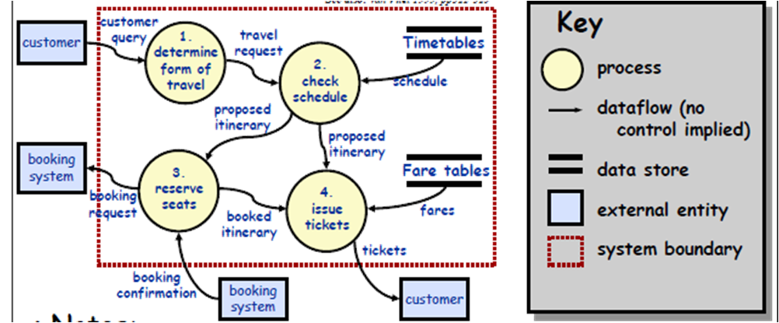
Functional Representation
Usually expressed by
  Data Flow Diagrams (DFDs)

Slide 11
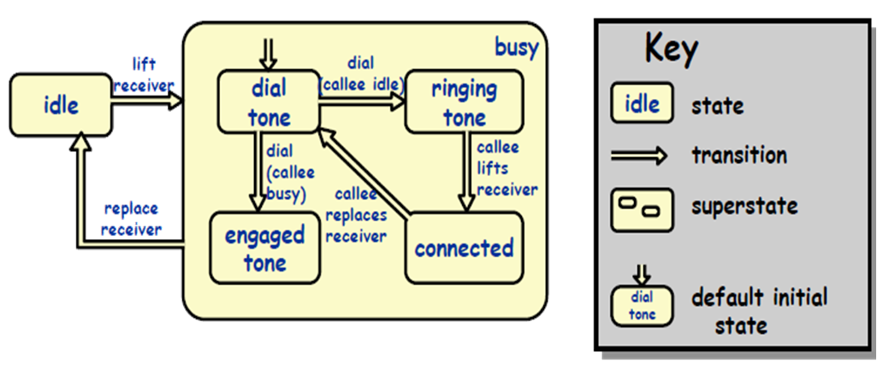
Behavioural Representation
Usually expressed by
  State Transition Diagram
    StateCharts

Slide 12
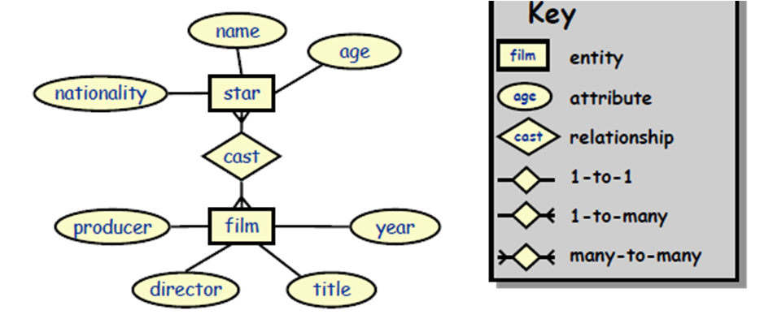
Data Modelling
Usually expressed by
  Entity Relationship Diagram

Slide 13
Software Design in SDLC
In SDLC (Software Development Life Cycle), Design phase is one of the most important phases.
In the software engineering context, design focuses on four major areas of concern: data, architecture, interfaces and components.

Slide 14
Design Process
During the design process, the software specifications are transformed into design models that describe the details of the data structures, system architecture, interface, and components.
The emphasis in design phase/process is on quality.
This phase provides us with representation of software that can be assessed for quality.

Slide 15
Design Process Activities
Architectural design
  Modules, inter-relationships etc
Abstract specification
  Services of each sub-system, constraints etc
Interface design
  Interface to other sub-system or outside env
Component design
  Services allocated to components and their interfaces designed
Data structure design
Algorithm design

Slide 16
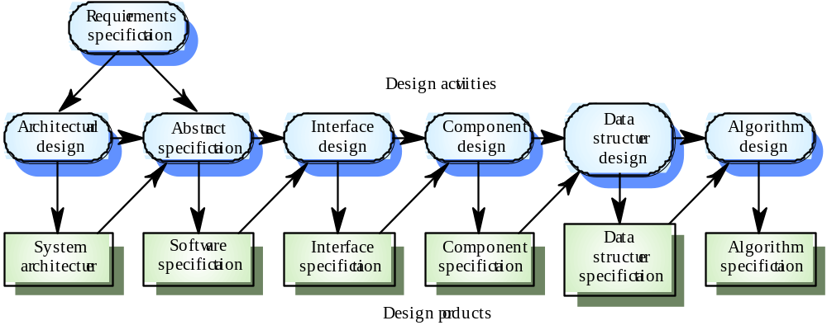
The Software Design Process

Slide 17
The software design process encourages good design through the application of fundamental design principles, systematic methodology and through review.

Slide 18
Why Design is important?
Without a proper design, we risk building an unstable system
  one that will fail when small changes are made
  one that may be difficult to test
  one whose quality cannot be assessed until late in the software process, perhaps when critical deadlines are approaching and much capital has already been invested into the product.

Slide 19
Levels of Software Design
Architectural design (high-level design)
  architecture - the overall structure, main modules and their connections
  addresses the main non-functional requirements (e.g., reliability, performance)
  hard to change
Detailed design (low-level design)
  the inner structure of the main modules
  detailed enough to be implemented in the programming language

Slide 20
Design Challenges
Design team should not do too much
  Detailed design should not become code
Design team should not do too little
  It is essential for the design team to produce a complete detailed design

Slide 21
Software Design should be:
Simple
Correct & Complete
Loosely coupled
Understandable
Adaptable

Slide 22
What is a good Design?
Coad & Yordon:
”A good design is one that balances the tradeoffs to minimize the total cost of the system over its entire lifetime.”

Slide 23
Qualities of a Good Design
Design should:
  exhibit good architectural structure
  be modular
  contain distinct representations of data, architecture, interfaces, and components (modules)
  lead to data structures that are appropriate for the objects to be implemented and be drawn from recognizable design patterns
  lead to components that exhibit independent functional characteristics
  lead to interfaces that reduce the complexity of connections between modules and with the external environment
  be derived using a reputable method that is driven by information obtained during software requirements analysis

Slide 24
How to know if Design is bad?
changes to single module propagate via dependencies to other Modules (Rigidity)
  even small changes can cause cascading effects to many places
code breaks in unexpected places having no conceptual relationship with the area that was changed (Fragility)
  fixing the problems causes new problems
code is so tangled that it's impossible to reuse anything (Immobility)
no understandability
a module could be reused in another system, but the effort and risk of separating the module from original environment is too high

Slide 25
Characteristics of good and bad design
Good Design | Bad Design
1. Change in one part of the system doesn't always require a change in another part of the system. Every piece of logic has one and one home. It is cost effective The logic is near the data it operates on. 5. System can be extended with changes in only one place. 6. Simplicity | One conceptual change requires changes to many parts of the system. Logic has to be duplicated. 3. Cost of a bad design becomes overwhelming. 4. Can't remember where all the implicitly linked changes have to take place. 5. Can't add a new function without breaking an existing function. 6. Complexity

Slide 26
How to avoid bad design?
Follow Design Principles
Use established Design Patterns

Slide 27
Software Design Principles
The design process should not suffer from tunnel vision
  – A good designer should consider alternative approaches.
The design should be traceable to the analysis model
The design should not reinvent the wheel
The design should minimise intellectual distance between the software and the problem as it exists in the real world
  That is, the structure of the software design should (whenever possible) mimic the structure of the problem domain.
The design should exhibit uniformity and integration
  A design is uniform if it appears that one person developed the whole thing.
  A design is integrated if care is taken in defining interfaces between design components.

Slide 28
Software Design Principles contd…
The design should be structured to accommodate unusual circumstances, and if it must terminate processing, do so in a graceful manner.
The design should be reviewed to minimize conceptual (semantic) errors
Design is not coding, coding is not design
  Even when detailed designs are created for program components, the level of abstraction of the design model is higher than source code.
The design should be structured to accommodate change
The design should be assessed for quality as it is being created

Slide 29
Software Design Principles ensure ….
When these design principles are properly applied, the design exhibits both external and internal quality factors. External quality factors are those factors that can readily be observed by the user, (e.g. speed, reliability, correctness, usability). Internal quality factors relate to the technical quality (which is important to the software engineer) more so the quality of the design itself.

Slide 30
Software Design Methods
In a Software development process, the Software Design Methodology (SDM) refers to specific set of procedures used to manage and control the SDLC (Software Development Life Cycle).
The choice of the SDM primarily depends upon several factors, namely,
  the type of the software being developed (such as standalone or distributed and networked; Strategic or operational etc.),
  the scope of the development project (such as revamp of the existing system or new system, the number of modules involved, underlying complexity of the coding, system testing and implementation etc),
  the resources constraints (such as time, money and expertise) etc.

Slide 31
Software Design Methods
Systematic approaches to developing a software design.
  Structured (Function-Oriented)
  Object-Oriented
  Data-Oriented (Data-structure-centered)
  Component-based
  Formal Methods

Slide 32
Software Design Methods
Structured Methods
  Process functions are identified
Object-Oriented
  develop an object model of a system
Data-Oriented
  Entities are determined for each sub-system, then entity inter-relationships are examined to develop the additional entities needed to support the relationships.
Component-based
  Divide the system into components
Formal Methods
  Requirements and programs are translated into mathematical notation

Slide 33
Which method to choose?
Data oriented design is useful for systems that process lots of data, e.g. database and banking applications
Structured design is useful for process intensive systems that will be programmed using a procedural language such as FORTRAN.
OO methods are useful for any system that will be programmed using an object oriented language such as C++.
Component-based Methods are used for the large systems that can be modularized.
Formal methods are considered to be an alternative to OO and classical design methods, but their use is expensive and claims of reduced errors remain unproven. However, the ability to formally validate the correctness of a software artifact is appealing and research on formal methods is ongoing.

Slide 34
Software Design Strategies
Divide-and-conquer/stepwise refinement
Top-down vs. bottom-up
Data abstraction and information hiding
Use of heuristics
  Heuristic is an algorithm that is able to produce an acceptable solution to a problem in many practical scenarios but for which there is no formal proof of its correctness. (E.g. packing large objects and small objects)
Use of patterns and pattern languages
Iterative and incremental approach

Slide 35
Design Documentation
“Design without documentation is not a design”
The design is usually documented as a set of graphical models.
Possible models
  Data-flow model
  Entity-relation model
  Structural model
  Object models

Slide 36
Design vs. Architecture
Architecture is concerned with the selection of architectural elements, their interaction, and the constraints on those elements and their interactions
Design is concerned with the modularization and detailed interfaces of the design elements, their algorithms and procedures, and the data types needed to support the architecture and to satisfy the requirements.
Architecture…is specifically not about…details of implementations (e.g., algorithms and data structures.)

